Slide 1
Label tag

Slide 2
Agenda
Label tag
Sample output
Label tag implementation

Slide 3
Label
Labels are used with input elements.
Labels will communicate with users what kind of input they have to fill into the input elements in HTML.
Label tag helps you to style the label, Link a label to specific input element and many more.
You can also provide labels without label tag. But you cannot style your label as you want.
Syntax:
Label without label tag.
Label name: <input type = “type of input element here” >
Label with label tag.
<label for=”id”> Label Name:</label>
<input type = “type of input element here” id = “id for label” >

Slide 4
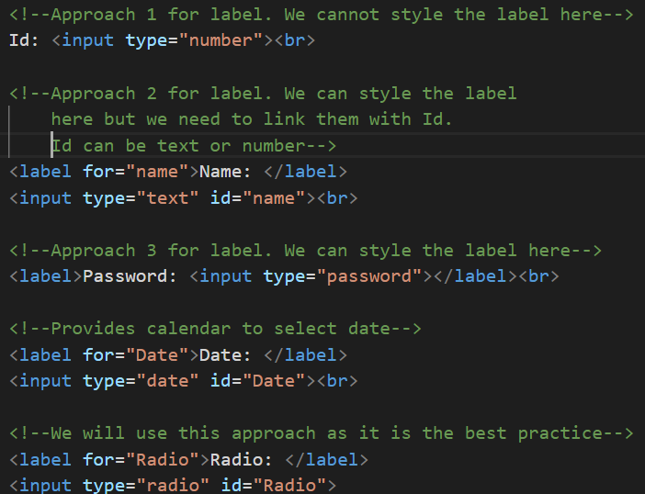
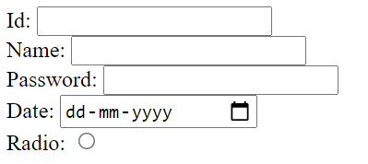
Sample output

Slide 5
Labels implementation
Let’s see implementation of label tag.

Slide 6
Summary
Label tag is used to convey what kind of data needs to be inserted into the input element.
We have seen various ways of using labels and we have also seen the best way of using Label Tag.
DO NOT WRITE ANYTHING
HERE. LEAVE THIS SPACE FOR
WEBCAM

Slide 7
Thank You
Proprietary content. ©Great Learning. All Rights Reserved. Unauthorized use or distribution prohibited

